Slide 1
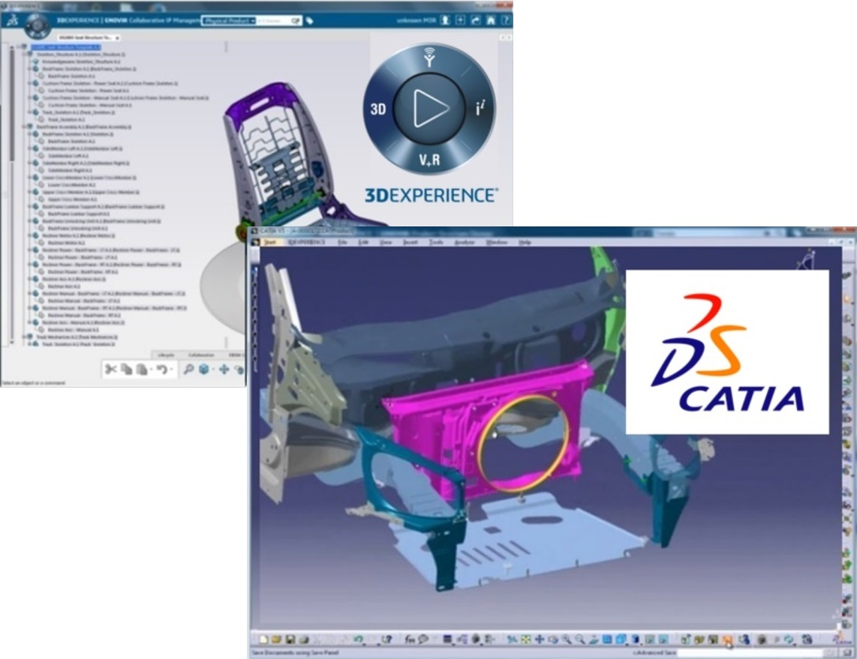
Managing Co-Existence of CATIA V5 and V6 (3DEXPERIENCE)
This presentation explores the strategies and best practices for managing the co-existence of CATIA V5 and CATIA V6 (3DEXPERIENCE) within the Honda supply chain.

Slide 2


Co-Existence Framework
Establish Use Cases
Define Principles
V5 for existing Honda models and external OEM programs still dependent on V5. V6 (3DEXPERIENCE) for new Honda models aligned with the DPM-centric approach.
Single source of truth per model/version - decide whether V5 or V6 will act as the authoritative dataset. Avoid parallel edits across V5 and V6 for the same dataset unless explicitly controlled through Honda's rules.
Establishing a clear co-existence framework with defined use cases and principles is crucial for managing the transition from CATIA V5 to CATIA V6 (3DEXPERIENCE) while ensuring data integrity and efficient reuse.

Slide 3



Data Exchange & Interoperability
Use Dassault's V5–V6 Coexistence Tools
Standardize Exchange Formats
Data Governance
Leverage the 3DEXPERIENCE 'V5–V6 Coexistence' portfolio to ensure backward compatibility. Supported scenarios include opening V5 data directly in V6 (with conversion to V6 representations) and saving 3DEXPERIENCE-managed data in V5 format for downstream users.
Use JT, STEP, or 3DXML (per Honda's guidelines) to exchange data and avoid geometry/data loss. Ensure PMI annotations (MBD) are preserved when moving data across platforms.
Tag datasets clearly with origin platform (V5/V6) and versioning information to avoid confusion. Maintain metadata consistency (material, process, tolerances).

Slide 4
IT & Process Support
Infrastructure
Process Documentation
Provision systems to run both CATIA V5 and V6 concurrently, including licensing management. Ensure VDI/cloud setup can support switching between platforms without latency.
Document internal supplier-specific rules for V5/V6 coexistence (e.g., when to convert, when not to convert). Establish escalation paths for data conflicts or duplicate datasets.
System Integration
Monitoring and Reporting
Integrate CATIA V5 and V6 with Honda's Azure cloud environment to enable centralized data management and prevent local duplication.
Implement monitoring and reporting tools to track data exchange, conversion, and reuse activities between CATIA V5 and V6 platforms.

Slide 5
To successfully manage the coexistence of CATIA V5 and V6, suppliers must adopt Honda's clear guidelines, leverage Dassault's coexistence tools, prevent data duplication, upskill their teams, and update their IT infrastructure and processes. By following these key actions, suppliers can ensure a smooth transition while preserving data integrity and enabling efficient reuse across both platforms.

